Slide 1
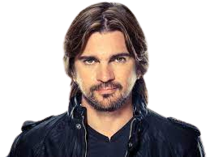


Juan Esteban Aristizábal Vásquez
Worldwide
Sings and Produces
“Juanes”

Slide 2

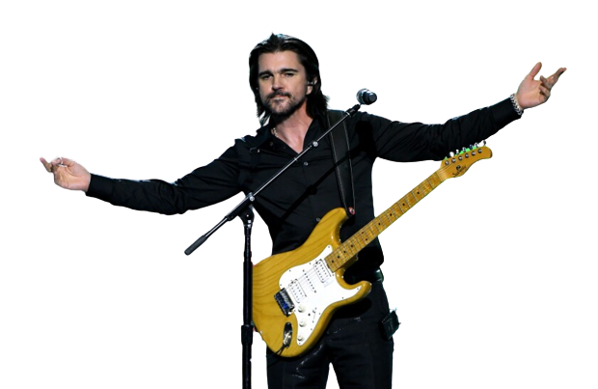
PLACE OF BIRTH

Slide 3

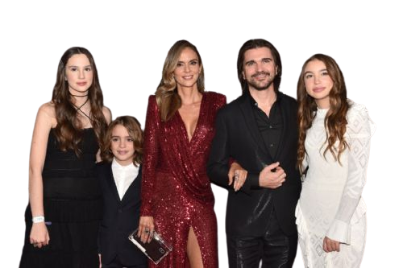
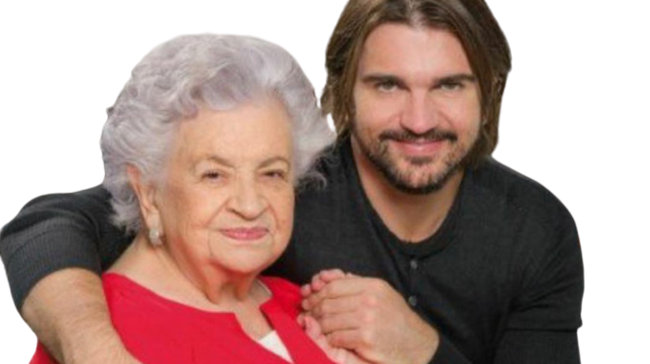

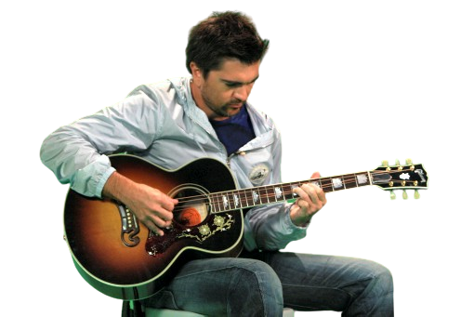

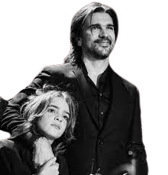

FAMILY history
Alicia Vásquez
Karen Martínez
Learned from his father,brothers
Javier Aristizábal

Slide 4

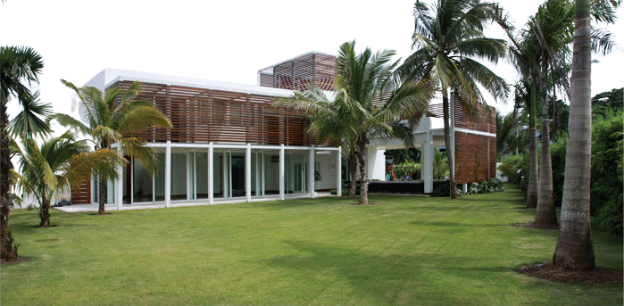





Place of residence
More than seven stairs
Garage
He has a Wondeful home
Modern Styles

